Slide 1
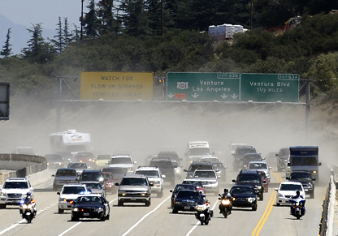
Valley Mobility Matrix
San Fernando Valley - Santa Clarita Valley A Unified Vision for the Valleys

Slide 2
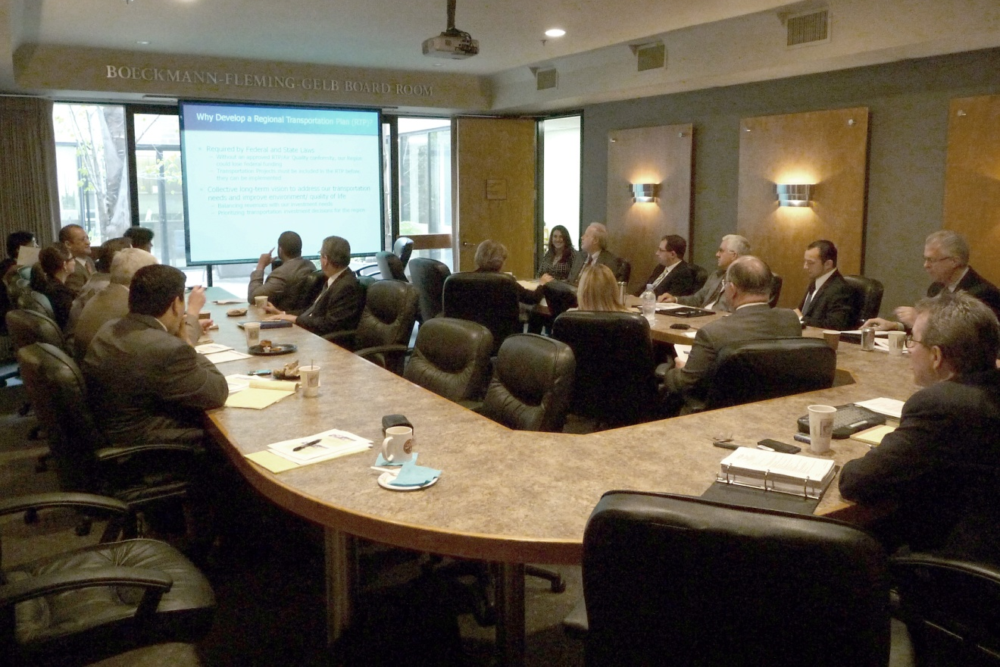
Valley Mobility Matrix
San Fernando Valley Council of Governments Technical Advisory Committee Transportation Task Force

Slide 3
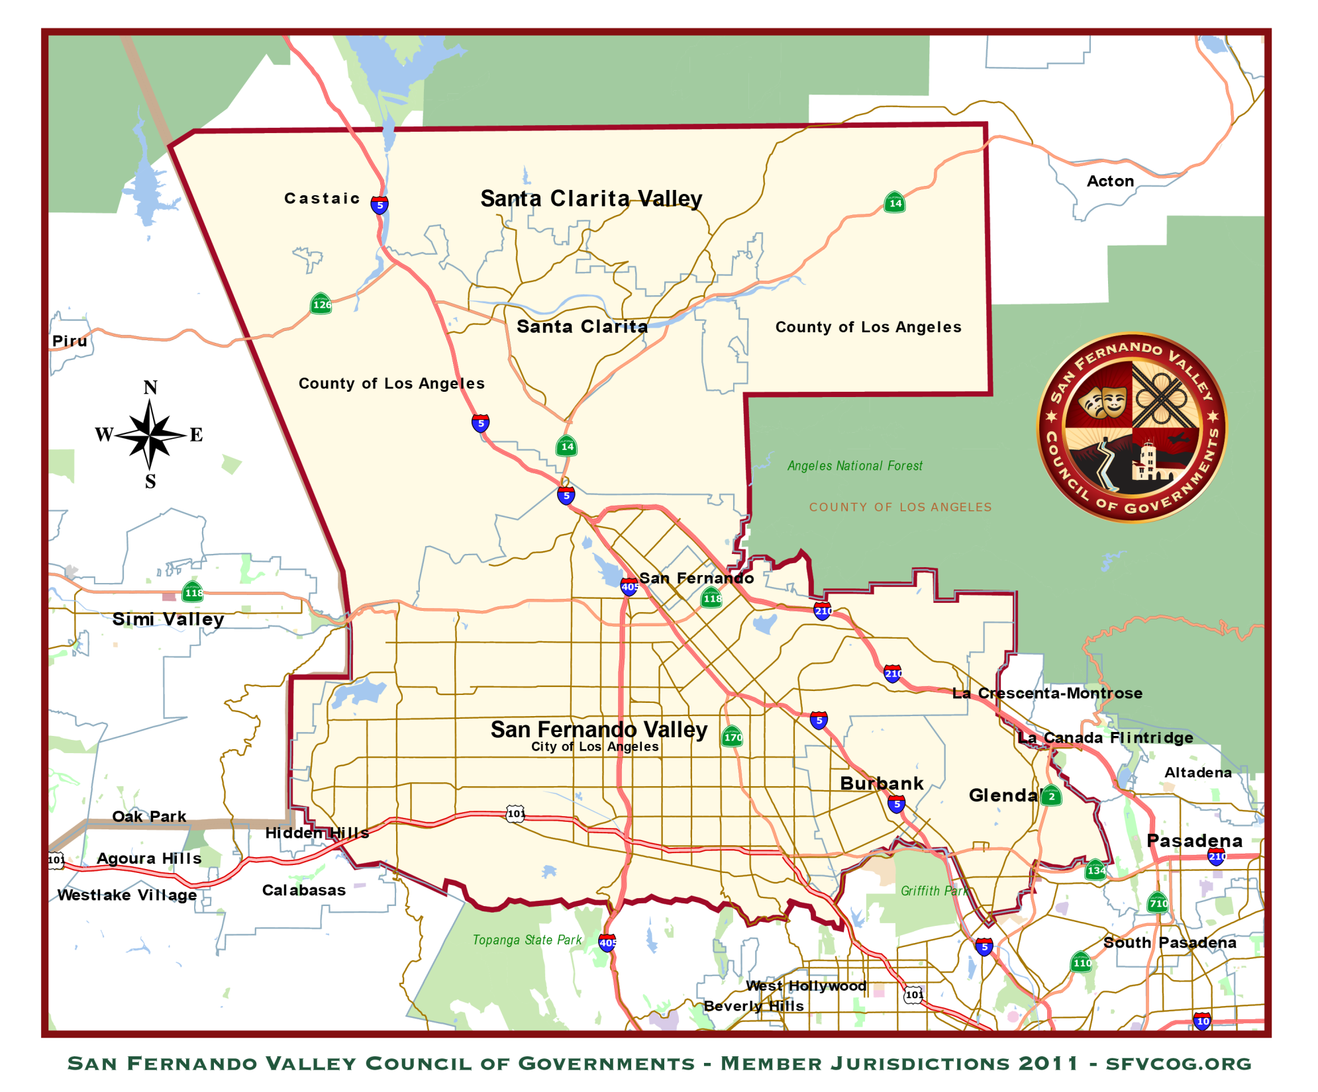
Valley Mobility Matrix
San Fernando Valley - Santa Clarita Valley
Subregion

Slide 4
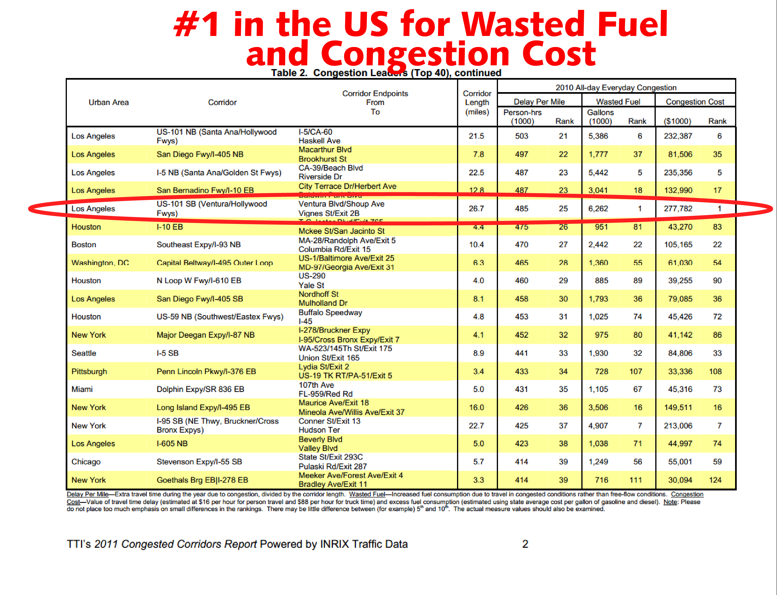
Valley Mobility Matrix

Slide 5
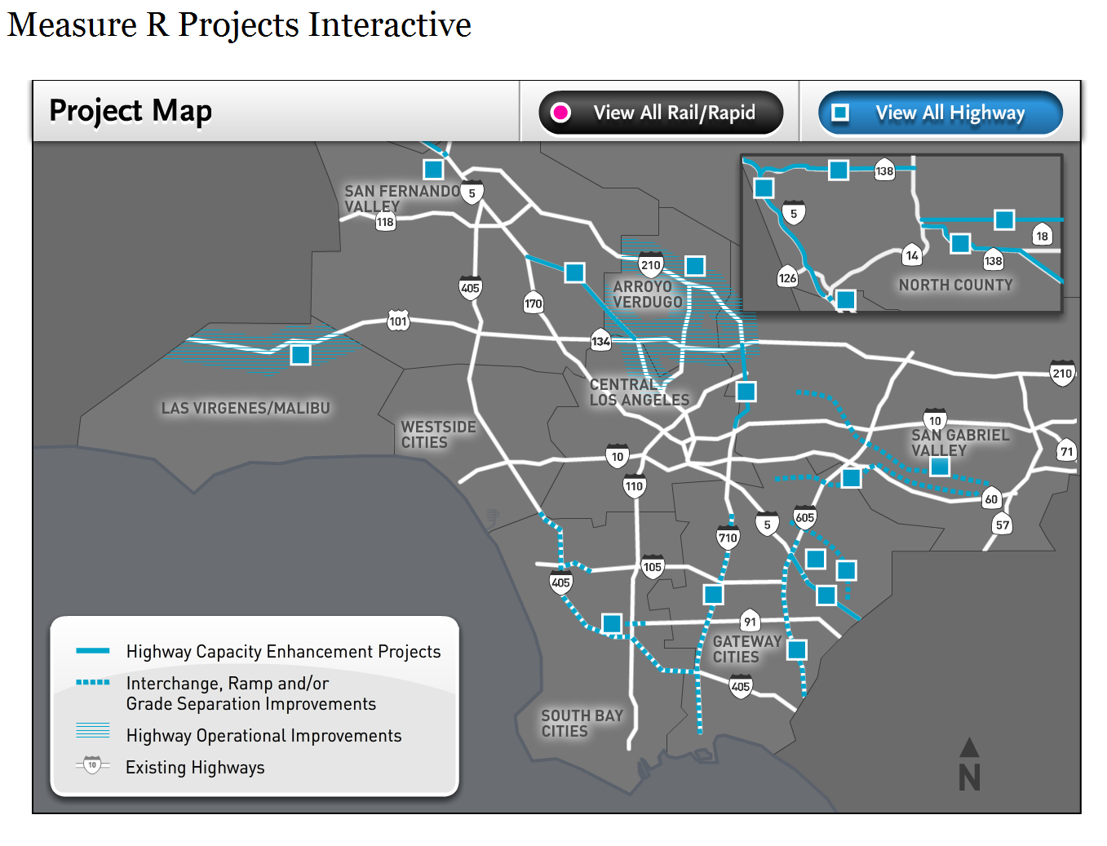
Valley Mobility Matrix

Slide 6
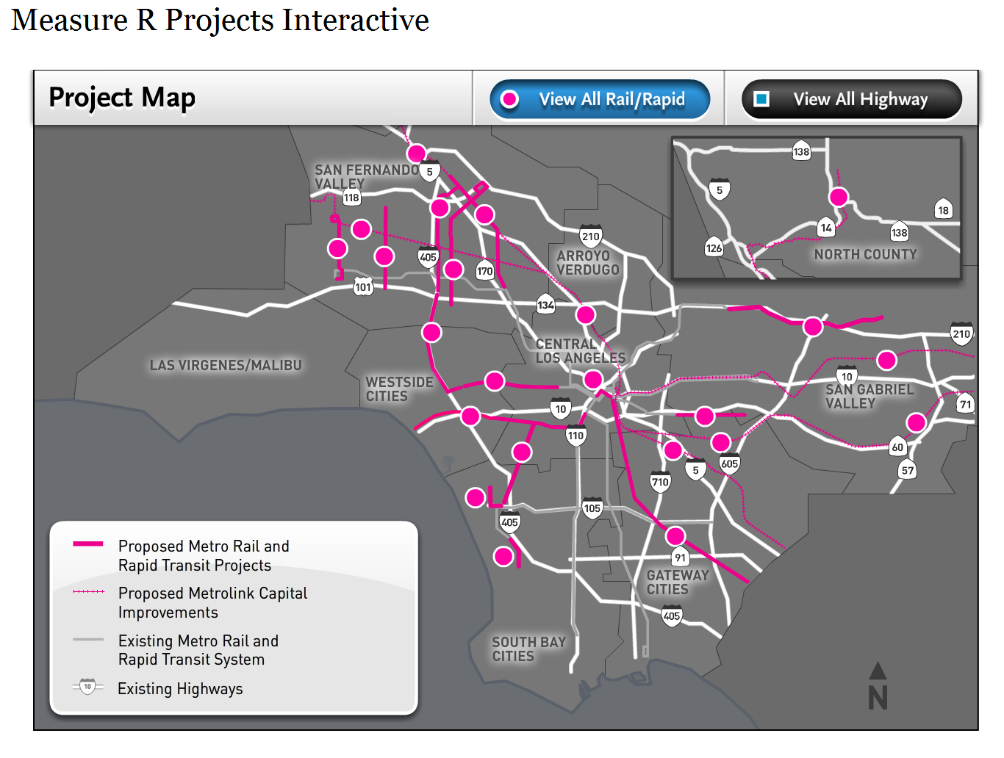
Valley Mobility Matrix

Slide 7
Valley Mobility Matrix
High Profile Initiatives
Funding
Propositions A & C
Measure R and J Extension
High Speed Rail – Proposition 1A
Metro Call For Projects 2013
Models
SCAG RTP/SCS
Metro – LRTP – SRTP

Slide 8
Valley Mobility Matrix
Priorities for SFV COG
“Geographic Equity”
Inter-Regional Connections
Subregional Network – Web vs. Hub and Spoke
Local Strategies & Best Practices
Resource Development Strategies
Partnerships and PPP

Slide 9
Valley Mobility Matrix
Priorities for SFV COG
“Geographic Equity”
Goals
Objectives
Benchmarks and Metrics
Modeling, Need & Demand
Growth Projections
Framework for Growth

Slide 10
Valley Mobility Matrix
Transit vs. Transportation
Funding Allocations - Reprogramming
Providing Transit Alternatives for the Transit Dependent
Providing Transit Dividends to Discretionary Riders to Relieve Congestion

Slide 11
Valley Mobility Matrix
Inter-Regional Connections
High-Speed Rail – Express Rail
Blended Strategies
High Desert Corridor
Inland Port
Coastal Rail
Goods Movement

Slide 12
Valley Mobility Matrix
Corridors and Alternatives
I-5 CA-14 AV Corridors
I-405 Sepulveda Pass
US-101 CA-134 Corridor
Alameda Corridor North
Super-Streets, Queue Jumpers, SPUIs, ITS as congestion relief for corridors
Corridor Economics

Slide 13
Valley Mobility Matrix
Inter-Regional Connections
Rail and Intermodal
Metrolink
LOSSAN Corridor – Express Rail – OLDA
Rail Improvements – Straightening
Safety Considerations – Double Tracking
Tunnel Replacement and Upgrades
Stations, Platforms and Relocation
Goods Movement
Intermodal Strategies
Logistics and Freight
Neighboring Subregions
Complementary Networks

Slide 14
Valley Mobility Matrix
Intra-Valley Improvements
Orange Line
Grade Separation
Conversion to Rail or Express Rail Supplement
Express BRT Service
Station Improvements
Extension to Bob Hope Airport
Connection to Pasadena Gold Line
Extension to Conejo Valley
Extension to Simi Valley
East SFV North South BRT(?) Routes
Improved SFV-Santa Clarita Connections

Slide 15
Valley Mobility Matrix
Efficient VMT/CPM Investments
High-Leverage Projects
Stretching Transportation Dollars
Comparative Technologies
Capitalization vs. M&O
Pinch Points
Missing Connectors
Passes: Sepulveda, Cahuenga, Newhall, Las Virgenes, Santa Susana

Slide 16
Valley Mobility Matrix
Subregional Network
First Mile/Last Mile Approaches
Transit Dependent - Alternatives
Discretionary - Dividends
Incentives - Deterrents
Emerging Technologies and Cost Benefits
Rails and Right of Ways

Slide 17
Valley Mobility Matrix
San Fernando Valley - Santa Clarita Valley Regional Connectivity

